Slide 1
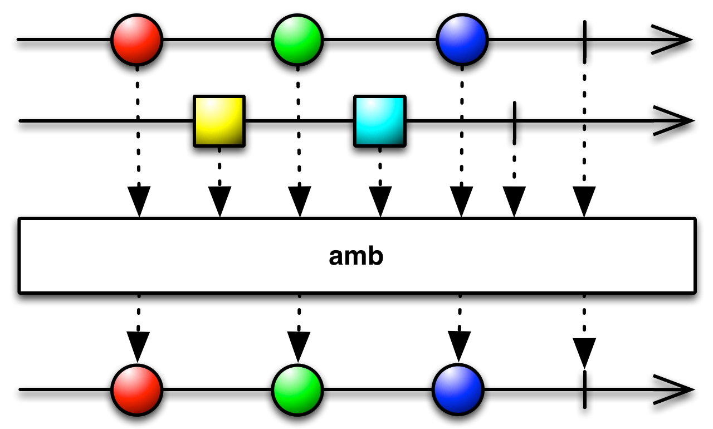
Introducing Reactive Programming
RxJava Reactive Streams
Victor Grazi
GMIT Core IT

Slide 2
Agenda
What is Reactive?
Why Reactive?
Observable basics
Marble diagrams
Concurrency
Cold Observables
Hot Observables
Demos
Basic operations
Controlling emission rate
Attaching to a feed

Slide 3
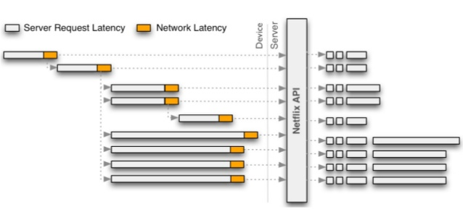

How Netflix uses RxJava from N network calls
Server Request Latency
Network Latency
Device
Server
Netflix API

Slide 4
What is Reactive?
Reactive Streams – standard for high-performance, asynchronous stream processing with non-blocking back pressure.
Declarative tools for concise, error free code, especially under high load and concurrency.
It’s a new programming paradigm – think in terms of streams instead of objects.
Simplify clean coding of asynchronous event driven programming.
Think “Future<>” that keeps on pumping!
The good news is, it does not change much from language to language.

Slide 5
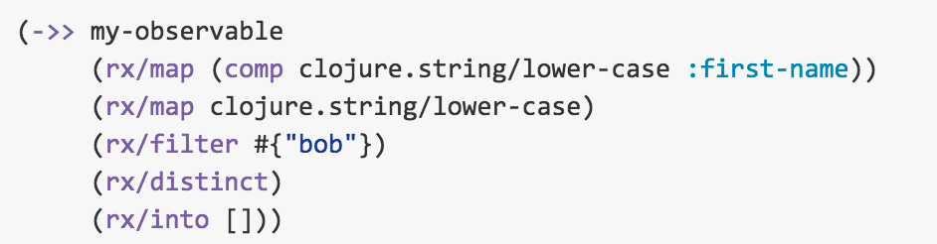
Cross language support
Java
CloJure
my_observable .map(Name::firstName) .map(String::toLowerCase) .filter(x -> x.startsWith("bob")) .distinct() .toList()

Slide 6
Difference between Java Stream API and Reactive
Java Streams | Reactive Streams
Pull based | Push based
Basically a way to iterate collections declaratively | Attach to real-time feeds
Generally synchronous data | Real-time, concurrency, flow control
Streams can only be used once | Reactive streams are highly reusable
No control of timing | Control back-pressure strategies
No composition of streams | Advanced composition and transformation
Finite amount of data | Data sizes from zero to infinity

Slide 7
Maven Dependencies
<dependency> <groupId>io.reactivex</groupId> <artifactId>rxjava</artifactId> <version>RELEASE</version> </dependency>
<dependency> <groupId>io.reactivex</groupId> <artifactId>rxjava-math</artifactId> <version>RELEASE</version> </dependency>

Slide 8
Basic Model
Everything is a stream of messages
Observables emit event messages
Subscribers (Observers) consume messages
Observables are immutable (operations return new Observables)
Observable
Observer
Observable
Emits messages from:
Remote services
Data feeds
Mouse events…
Message stream
Observer
Implemented by Subscriber:
onNext()
onError()
onCompleted()
Examples:
Events
Query results
Computations
Even errors!

Slide 9
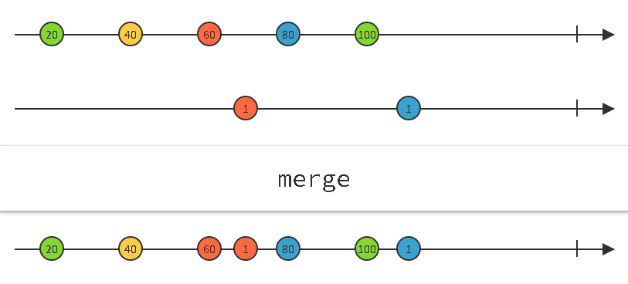
MARBLE DIAGRAMS
http://rxmarbles.com/ Interactive marble diagrams

Slide 10
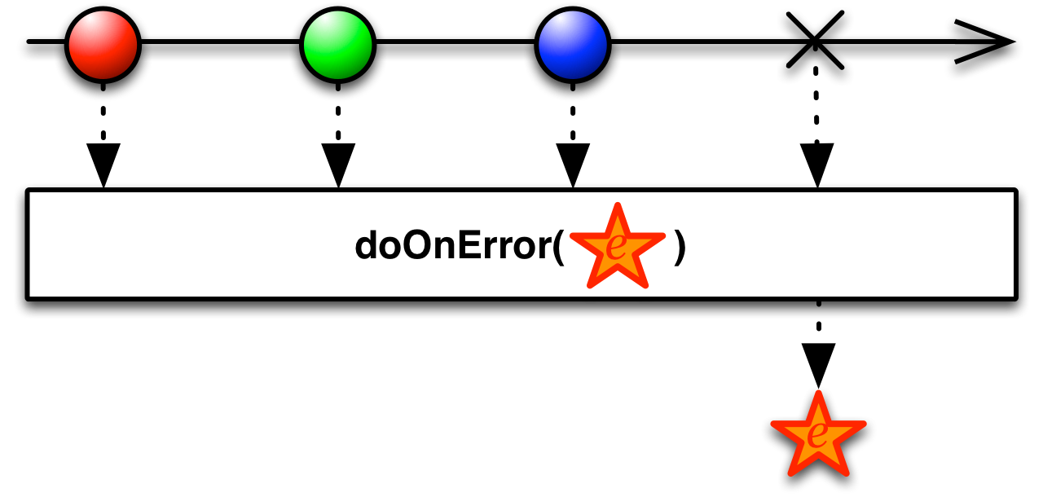
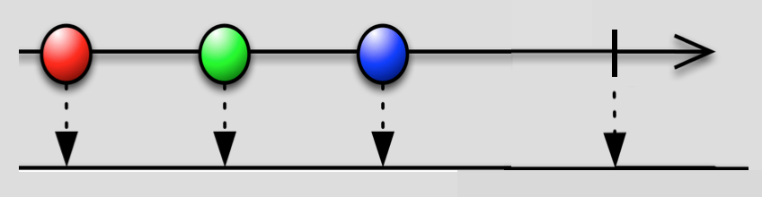
An Observer receives notifications:
interface Observer<T> void onNext(T t); void onError(Throwable t); void onCompleted();
class Subscriber implements Observer<T>
public final void unsubscribe();
onNext()
onCompleted()
onError()
(onError() and onCompleted() are terminal operations.)

Slide 11
…Attaching a full Subscriber
observer.subscribe(
v -> System.out.println(v), // happy path
error -> errorHandler(error), // error handler
() -> System.out.println(”Done ") // completion
);

Slide 12
Transform and combine the Observable
Or
Observable
.map(…)
.subscribe(…)
Or even
Observable
Observable
.filter(…)
.subscribe(…)
.filter(…)
.map(…)
.doOnNext(System.out::println)
.subscribe(…)
.filter(…)
.map(…)
.subscribe(…)
etc., etc., etc.
Each transformation returns a new resultant Observable.
Notes:
Talk about assigning each step to a new Observable variable if you have trouble getting things to compile. It makes it easier to see what has gone wrong and what is required to correct it

Slide 13
Concurrency
Observers are synchronous; concurrent calls are handled in sequence
No need to code defensively for concurrency
And no loss in latency due to synchronization

Slide 14
Asynchronous Streams
Built in support for concurrent publishers and subscribers
Observable.observeOn(scheduler) – Specifies the thread for the Observer
Observable.subscribeOn(scheduler) – Specifies the thread for the Subscriber
Types of schedulers
Schedulers.immediate() – Parks current process and uses current thread
Schedulers.computation() – The system-assigned computation thread
Schedulers.io() – The system-assigned IO thread
Schedulers.trampoline() – Uses the current thread, once it is done here
Schedulers.newThread() – Uses a new thread
Schedulers.from(Executor) – On the named executor

Slide 15
Cold Observables and Hot Observables
Cold Observables
Won’t begin pumping until a subscriber is attached.
Each subscriber receives all of the events, beginning from the historical first.
Hot Observables
Generally read live data, for example data feeds or mouse movements.
Begin pumping on connection.
Each subscriber gets the latest feeds as they pump

Slide 16
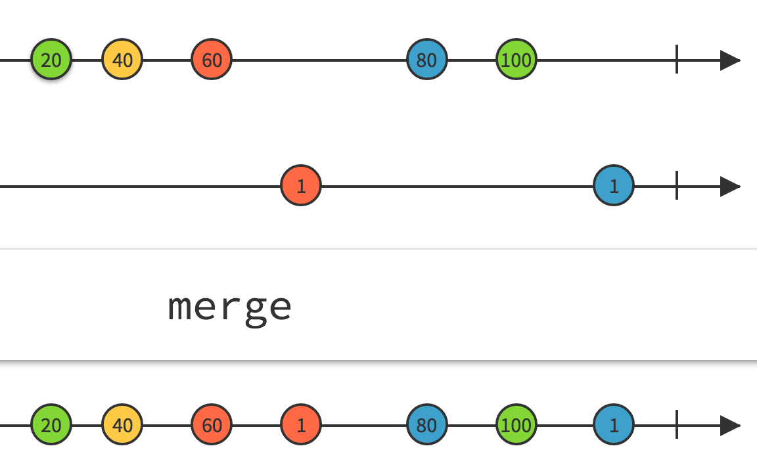
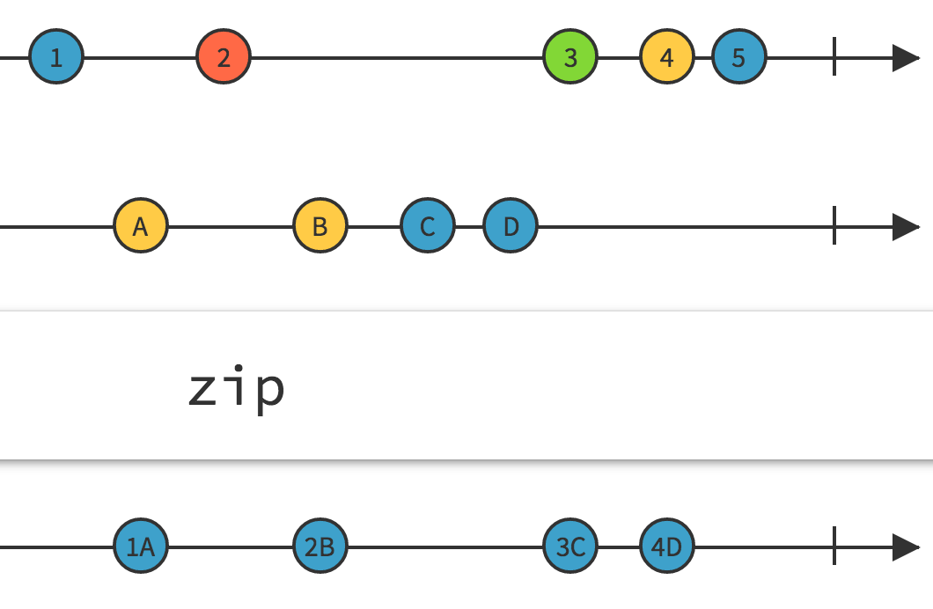
Combine Observables to produce new Observables
Methods take one stream as input and return another stream.
merge, mergeWith – merges elements as they arrive.
zip, zipWith – combines elements in sequence.
amb – returns the first stream to emit an element.

Slide 17
Creating COLD Observables
Observable.just(value) – Creates instance that emits exactly one (to nine) values.
Observable.from(values) – Accepts Collection<T> or array, to create an Observable<T>, which emits the values of the collection.
Observable.range(i, n) – Produces n consecutive integers starting from i.
Observal.interval(n, TimeUnit t) – Emits a count, every n time units
etc. etc. etc.

Slide 18
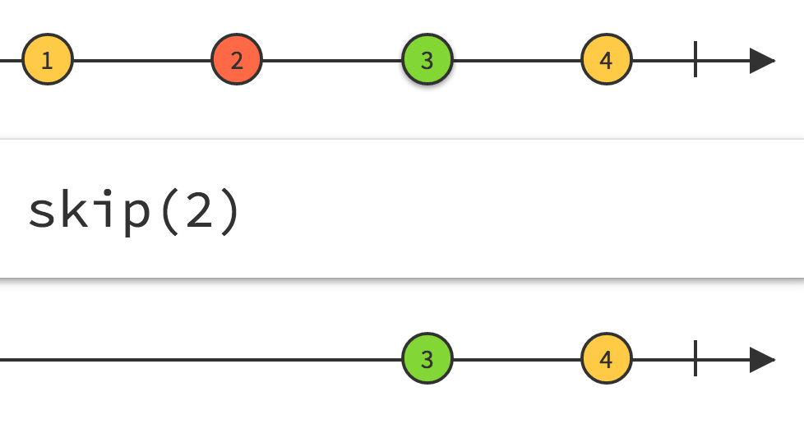
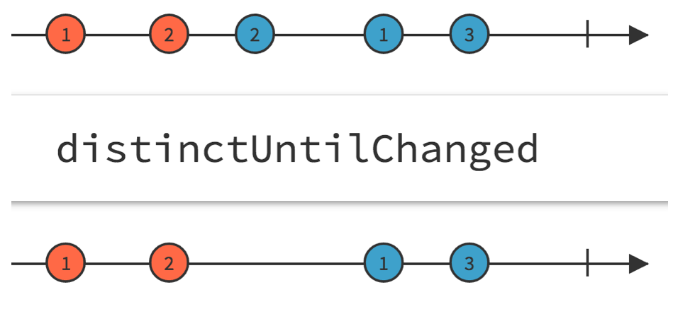
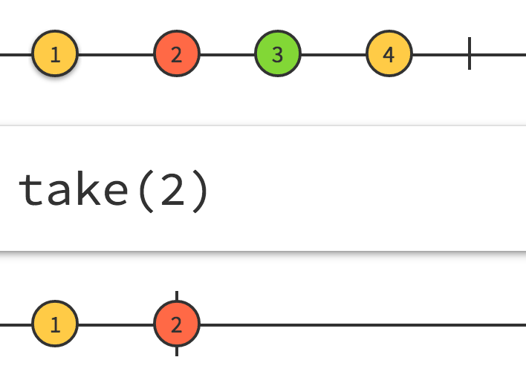
Transforming Observables
Methods take one stream as input and return another stream.
Observable.take(n) – Takes first n elements only.
Observable.skip(n) – Skips first n elements, then takes the rest
Observable.distinct() – Returns a new Observable with duplicates eliminated.
Observable.distinctUntilChanged() – Eliminates consecutive duplicates.
Observable.filter((x)->condition()) – Retains elements matching filter condition.
Observable.map(Some::mapper) – Replaces elements with other elements.
Observable.flatMap(Some::mapper) – Replaces elements with Observables.

Slide 19
Additional Cold Observables (for Development)
Observable.empty() – Completes on the first subscription, without emitting any values.
Observable.never() – Emits no values and never completes.
Observable.error() – Emits an onError() notification immediately on every subscriber. No other values are emitted.
Observable.doOnNext() – Diagnostics

Slide 20
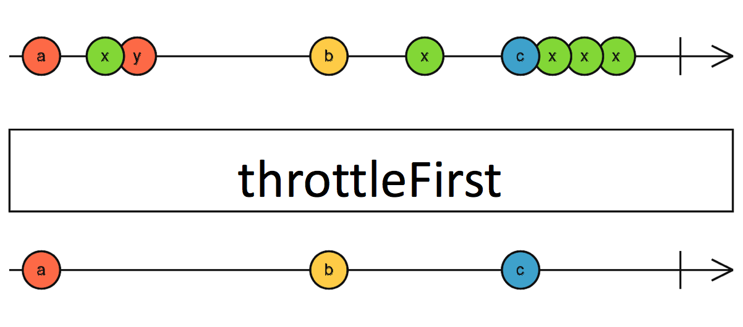
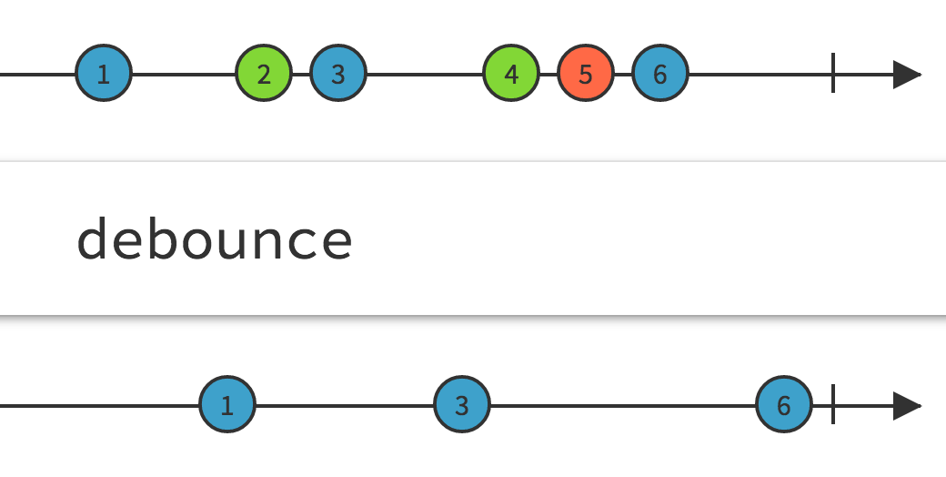
Time Filtering
Select elements based on timing
throttleFirst() – Takes only the first after every n time units
throttleLast() – Takes only the last element after every n time units
debounce() – Takes only the last event of each set in the specified time.
timeout() – Issues an exception if no events before timeout
debounce

Slide 21
Creating Hot Observables
Call “publish” on a cold Obervable
ConnectableObservable<Long> hotObservable = Observable.interval(1, TimeUnit.SECONDS).publish(); hotObservable.subscribe( val -> System.out.println("Subscriber >> " +val));
Call “connect” to start pumping, with or without subscribers
hotObservable.connect();
Notes:
http://blog.xebia.in/2015/09/01/day1-building-an-application-from-scratch-using-rxjava-and-java8/

Slide 22
Introducing Reactive Programming RxJava Reactive Streams and Extensions
Demo
Victor Grazi
GMIT Core IT

Slide 23
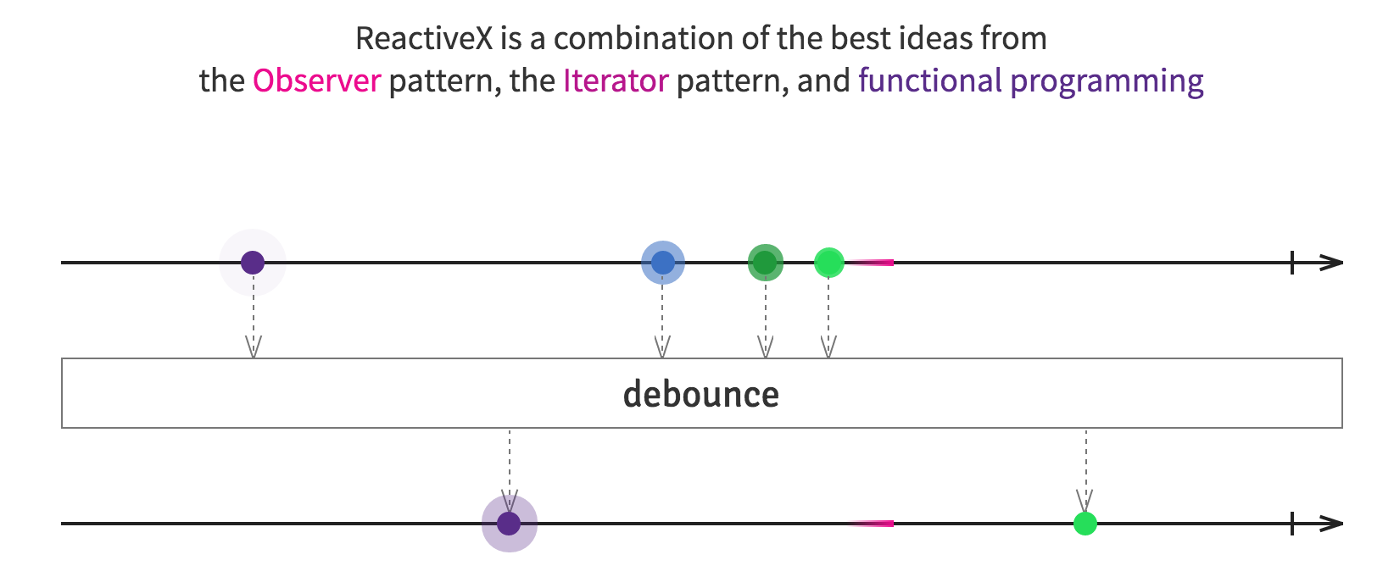
Introducing Reactive Programming RxJava Reactive Streams and Extensions
?
?
?
?
Q&A
Victor Grazi
GMIT Core IT
Victor Grazi
GMIT Core IT

Slide 24
Counting letters
private void launch() { List<String> words = Arrays.asList( "the", "quick", "brown", "fox", "jumped", "over", "the", "lazy", "dogs" ); Observable.from(words) .flatMap(word -> Observable.from(word.split(""))) .distinct() .sorted() .zipWith(Observable.range(1, Integer.MAX_VALUE), (string, count)->String.format("%2d. %s", count, string)) .subscribe(System.out:: println); }

Slide 25
Metronome example
private void launch() { Observable fast = Observable.interval(1, TimeUnit.SECONDS); Observable slow = Observable.interval(2, TimeUnit.SECONDS); final int[] count = {1}; Observable.merge( fast.filter(x->!isSlowTime()), slow.filter(x->isSlowTime()) ) .map(x-> count[0]++) .subscribe(x-> System.out.println(x + " " + new Date())); sleep(50_000); }

Slide 26
Emitter sample
public static void main(String[] args) { SomeFeed<PriceTick> feed = new SomeFeed<>(); Observable<PriceTick> obs = Observable.fromEmitter((AsyncEmitter<PriceTick> emitter) -> { SomeListener listener = new SomeListener() { @Override public void priceTick(PriceTick event) { emitter.onNext(event); if(event.isLast()) { emitter.onCompleted(); } } @Override public void error(Throwable e) { emitter.onError(e); } }; feed.register(listener); }, AsyncEmitter.BackpressureMode.BUFFER); ConnectableObservable<PriceTick> hotObservable = obs.publish(); hotObservable.connect(); hotObservable.subscribe((priceTick) -> System.out.printf("%s %4s %6.2f%n", priceTick.getDate(), priceTick.getInstrument(), priceTick.getPrice())); }

Slide 27
SomeFeed<PriceTick> feed = new SomeFeed<>();
Observable<PriceTick> obs =
Observable.fromEmitter((AsyncEmitter<PriceTick> emitter) -> { SomeListener listener = new SomeListener() { @Override public void priceTick(PriceTick event) { emitter.onNext(event); if (event.isLast()) { emitter.onCompleted(); }} @Override public void error(Throwable e){ emitter.onError(e); } }; feed.register(listener); }, AsyncEmitter.BackpressureMode.BUFFER);
ConnectableObservable<PriceTick> hotObservable = obs.publish();
hotObservable.connect();
``

